Slide 1
Exploring alternative methods for distinguishing between different groups of snow crab in the field
Determining carapace condition from field photos or near-infrared spectroscopy using statistical methods or AI
Notes:
The chromameter is a tool for precise and objective assessment of surface color

Slide 2
Background
Snow crab grow by periodically shedding their old, smaller, hard shell and forming a new, larger and soft shell, which subsequently hardens over time. With respect to managing the snow crab fishery, it is important to distinguish soft-shelled crab for two reasons:
To quantify recruitment to the fishery, which is used for modeling the dynamics of the snow crab population and determining the status of the commercial stock.
To estimate the quantity of soft-shelled crab being caught by fishermen. Soft-shelled crab are of no commercial value, but are vulnerable to mortality even when fishermen return them to the water.
Currently, soft-shelled crab are distinguished using subjective external characteristics of the crab’s shell, such as colour, opacity, iridescence, or the quantity of surface organisms on the crab shell. Training and field testing is required to achieve the desired level of consistency between field samplers, with varying levels of success. The task is further complicated by the fact that the external appearance of crab varies between different locations and over the field season, creating uncertainty as to the reliability of these observations. Thus, there is a need of a way objectively distinguish between soft and hard-shelled crab in the field.

Slide 3
Objectives
Gather a dataset on individual snow crab which contains both traditional measurements and observations, as well as new measurements relating to different material properties of snow crab.
Examine the relationships between the new and old observations, with a special focus on distinguishing between new and old crab, i.e. soft and hard crab, in the field.

Slide 4
Snow crab measurement study:
Goals:
Gather data set to explore how snow crab material properties change through time after moulting.
Identify new versus old shelled crab using high dimensional data (e.g. NIR, ultrasound, photos) and relate to lower dimensional data observations.
Strategy:
Cluster analysis on higher dimensional data (NIR & images), control for nuisance effects (individual variation, sample temperature, maturity, size)
If 2 clusters are clear, map onto new/ old shell group (test that it works)
Measurement | Description | Location | Seasonal variation | Expected role | Ease of measurement
Crab size | Carpace width |  | Does not change | Nuisance effect | easy
Maturity | Bigger claws |  | Does not change | Identification is interesting | easy
Hemolymph | Crab blood sample | Base of the 5th pereiopod | ? | Disease monitoring? | hard
Colorimeter | Crab | Chela & merus
NIR | Near infrared spectroscopy | Chela & merus |  |  | hard
Photos |  | Dorsal and ventral | Carapace appearance |  | easy
Meat yield | Proportion of meat inside crab |  | Steady increase in the months following moult | Soft / hard shell identifier | hard
Moult
Start of year
New-shelled
Later in year
Old-shelled
Following year
1 year later …

Slide 5
Methods : Sampling
When : Sept 4th to 11th, 2023.
Where : Off the coast of Cheticamp.
Vessel : CCGS M. Perley.
Gear :
3 small 1.2m diameter fine-meshed conical snow crab traps (+1 spare).
Recovered commercial traps (5 traps in all, only trap no. 4 sampled).
Sampling target : Male snow crab, stratified by size, maturity and carapace condition.

Slide 6
Methods: Measurements
For each sampled snow crab, apply the following suite of measurements :
Standard measurements and observations (carapace and chela size, carapace condition, etc.).
Durometer (chela).
Colorimeter (chela and merus).
Near-infrared field spectrometer (Tellspec NIR) (chela and merus).
Refractometer on a small hemolymph sample.
Photos (ventral and dorsal, chela time permitting).
Meat content (from samples brought to the lab).
Hemolymph sample for protein measurement using refractometer.

Slide 7
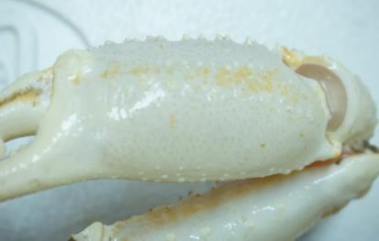
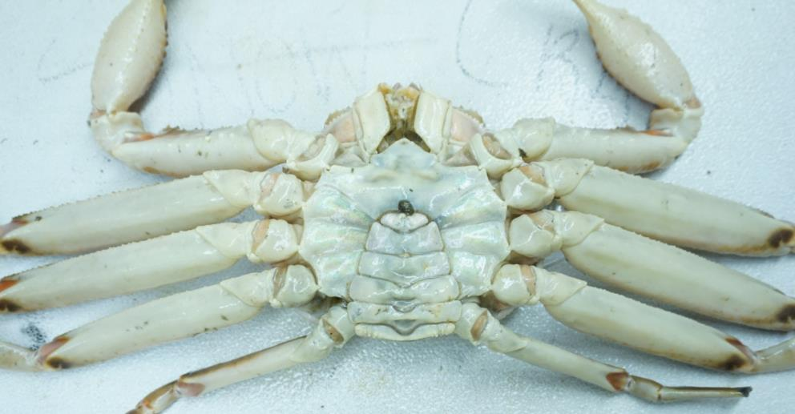
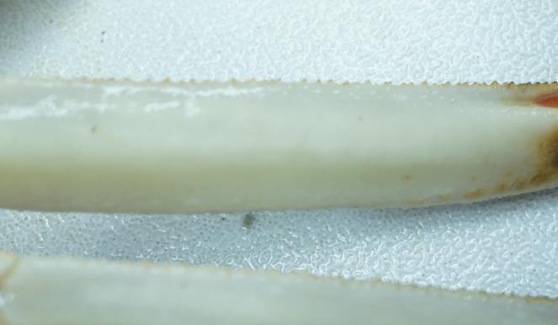
Methods: Measurement locations
Chela
Merus
Ventral view

Slide 8
Methods: Standard measurements
Standard crab measurements:
Carapace width & chela height.
Carapace condition.
Sex & maturity.
Misssing leg pattern.

Slide 9
Methods: Near-infrared (NIR) Spectrometer
Chiller was kept at 43-52 Fahrenheit.
All crab were kept in chiller prior to sampling, one crab at a time.
Prepare new project on Ipad.
Connect NIR and complete 3-4 scans to warm up machine.
Scan chela 3 times, then scan merus of 2nd pereopod 3 times.
When applying the NIR device, plastic wrap was initially used to protect it, then a plastic disk from the colorimeter was used. Crab sampled used one or the other. Plastic wrap was too easily damaged. Plastic disk became scratched during use. Both these methods are ad hoc attempts to protect instrument and may have influenced the resulting NIR spectra.
Notes:
The chromameter is a tool for precise and objective assessment of surface color

Slide 10
Methods: Other
Take colorimeter reading (chela & merus of 2nd pereopod and chela). L*a*b color scale was used.
Take durometer reading (chela). Durometer was old and uncalibrated.
Photos dorsal and ventral photos with fairly controlled lighting and fixed distance from crab.
Notes:
The chromameter is a tool for precise and objective assessment of surface color

Slide 11
Methods : Hemolymph sampling
Spray area of hemolymph sampling with 70% ETOH
Area of sampling: distal dorsal carapace, take picture.
Ventral side at the base of the 5th pereiopod.
Using a 5ml syringe, sample 2-3 ml of hemolymph.
Place 1-2 drops on refractometer.
Read and record protein amount.
Clean refractometer with distilled water and Kim wipes.
Units in mmol/L (probably).
Intended use: Hemolymph protein content normally decreases after moulting, but can vary between individuals via stress or other factors.
Notes:
The chromameter is a tool for precise and objective assessment of surface color

Slide 12
Frozen samples:
During the course of the study, the chiller used to store crab prior to sampling broke down. A a remedy, a random sample of ~20 crab were frozen.
Some of these crab may have been measured, but other were not. Crab were not labelled, so matching crab to the existing data set is difficult. It may be possible to achieve matching by using crab size measurements and photos. Also, crab missing their 2nd pereiopod likely indicated that they were sampled.
For each crab sampled, the 2nd pereiopod was datached and frozen for later measurement (e.g. meat content).
Sample leg that was scanned by cutting it with shears and freeze in Ziplock (joint of leg should be sprayed with 70% ethanol before and after leg cutting).

Slide 13
Methods: Equipment
IPad (data entry).
Calipers.
Tellspec Near-infrared Spectrometer (NIR) (+ cling wrap).
Colorimeter (Minolta CR-400 Chroma Meter) (+ alcohol swabs for cleaning).
Durometer (preferably calibrated).
Refractometer (+ needles, alcohol spray bottle)
Laboratory samples:
Ziplocks bags for merus samples (+ access to freezer).
Chargers for various devices.
Dissection tools.
Stationary (pencils, erasers, …)
Shop towels.

Slide 14

Methods : Sampling stratification
Male snow crab only.
Maximum of 5 crab per category.
Categories stratified by:
Maturity (morphometrically immature and mature).
Carapace condition (1&2 grouped together, then 3, 4 and 5).
Size (10 mm size bins).
75-84 mm, 85-94 mm, 95-104 mm, 105-115 mm, and 115 + mm. Carapace width.
Dorsal view
Ventral view

Slide 15
Methods : Sampling stratification
 | Carapace Condition (immature)
Size Class | 1-2 | 3 | 4 | 5
75-84 mm
85-94 mm
95-104 mm
105-114 mm
115-124 mm
 | Carapace Condition (mature)
Size Class | 1-2 | 3 | 4 | 5
75-84 mm
85-94 mm
95-104 mm
105-114 mm
115-124 mm

